Slide 1
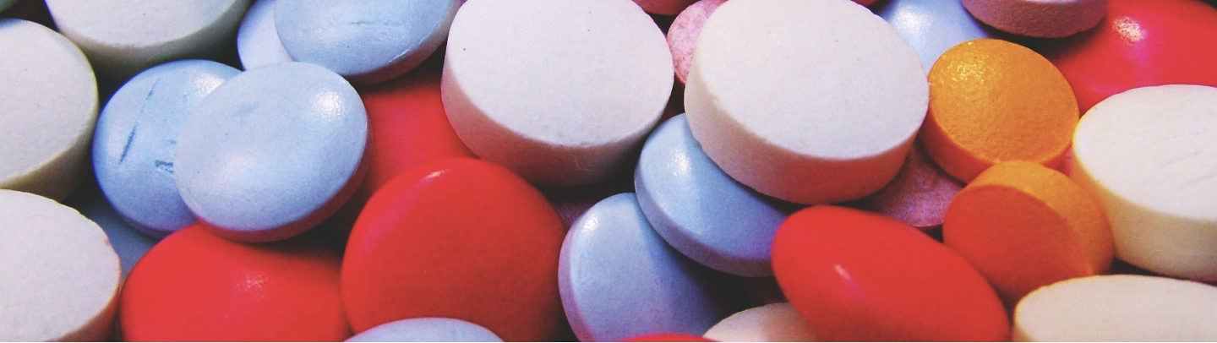

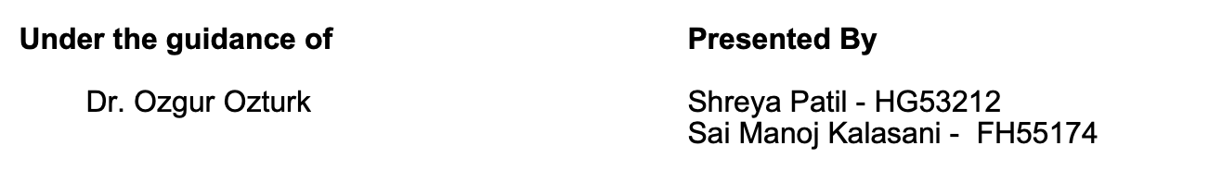
Phase 3

Slide 2
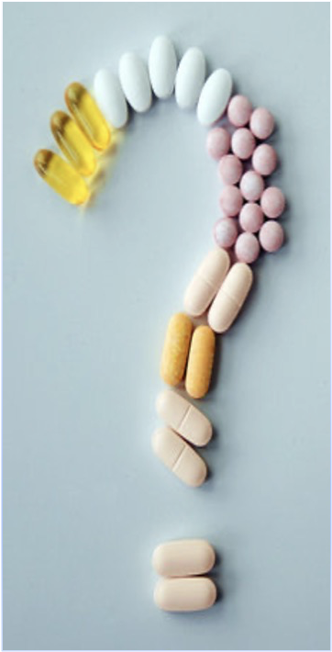
Problem Statement
To classify the Severity of Adverse Drug Effects
Risks in taking any medicine.
Thalidomide - sleeping pill, adverse effect : Thousands of babies born worldwide with malformed limbs.
According to CDC more than 1 million individuals visits emergency departments for adverse drug events each year in the United States.
About four in five (82 percent) emergency department visits for antibiotics allergic reactions.

Slide 3

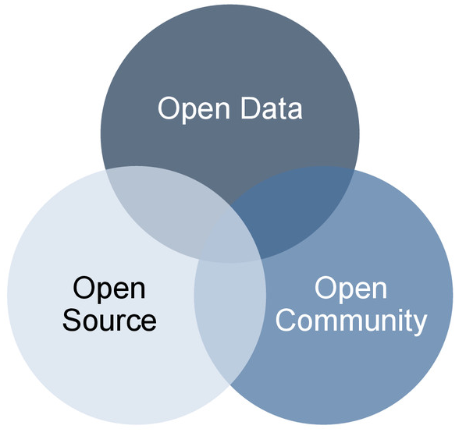
Dataset
Source: openFDA (public FDA data) : https://open.fda.gov/data/downloads/
Data available from 2003
Size of each file: 600 - 700 MB
Data Shape:
36000 records , 27 columns

Slide 4
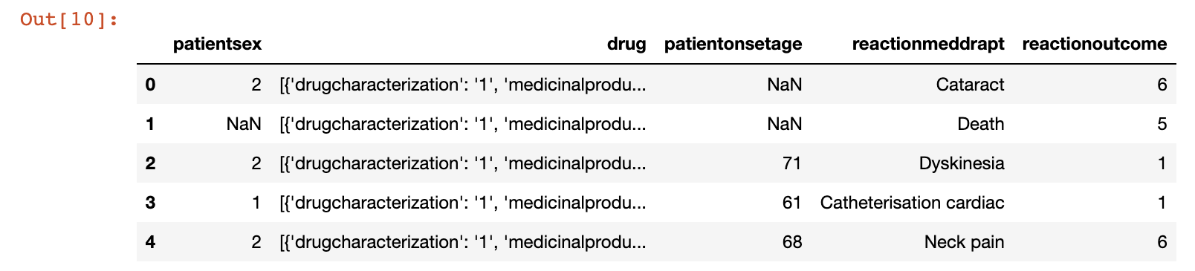
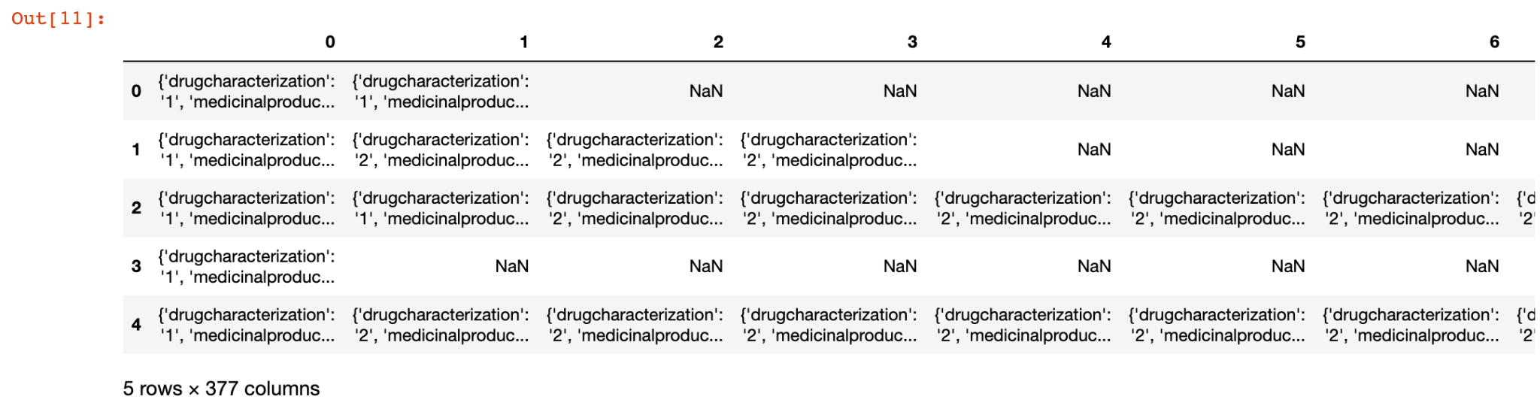
Data Wrangling

Slide 5
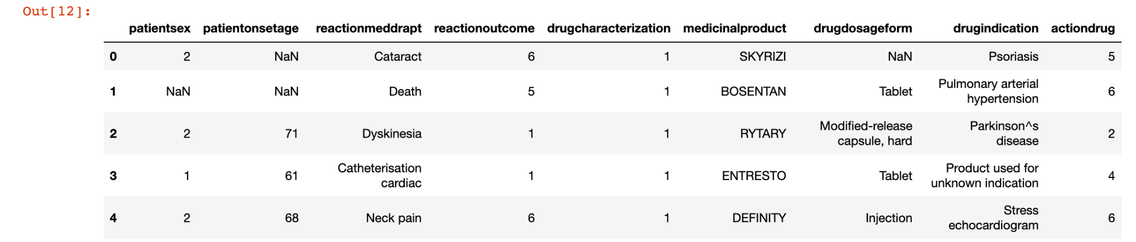
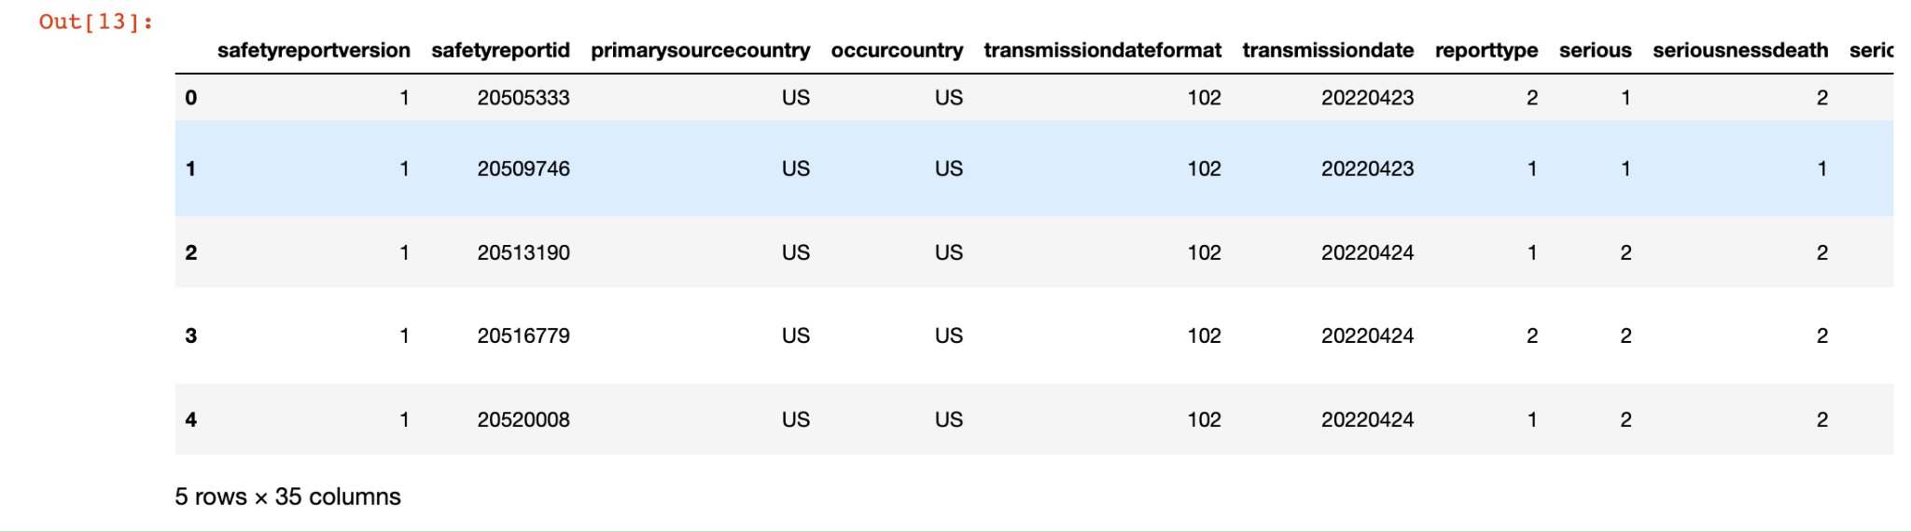

Slide 6
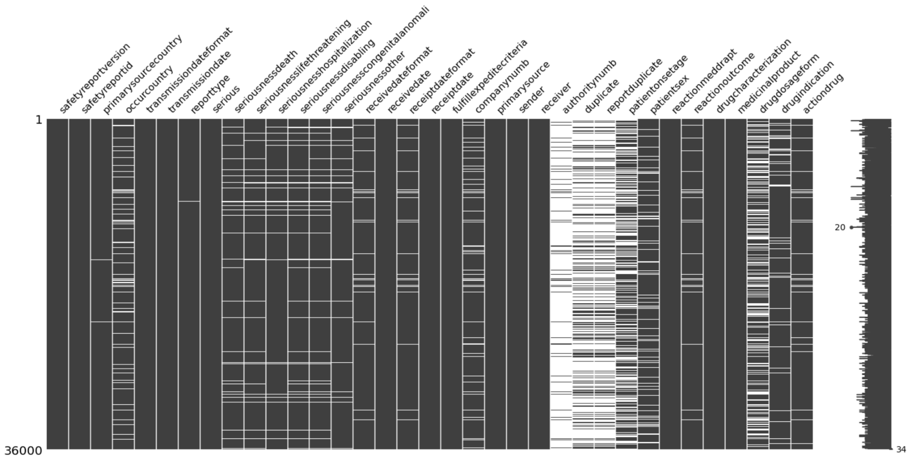
Missing Values

Slide 7
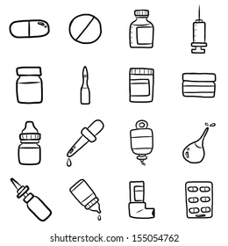
Data Cleaning
Changing datatype
Distribution of categorical values
Converting binary values from 2 to 0
Categorizing Drug Dosage form
Creating Age bins

Slide 8
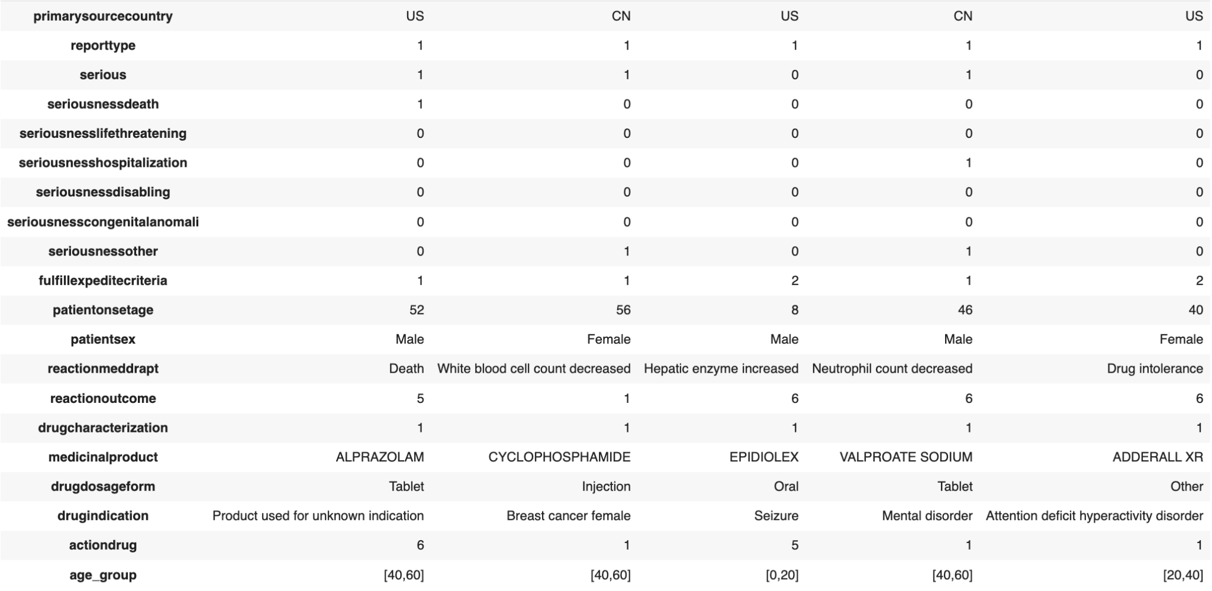
Features after cleaning the dataset

Slide 9
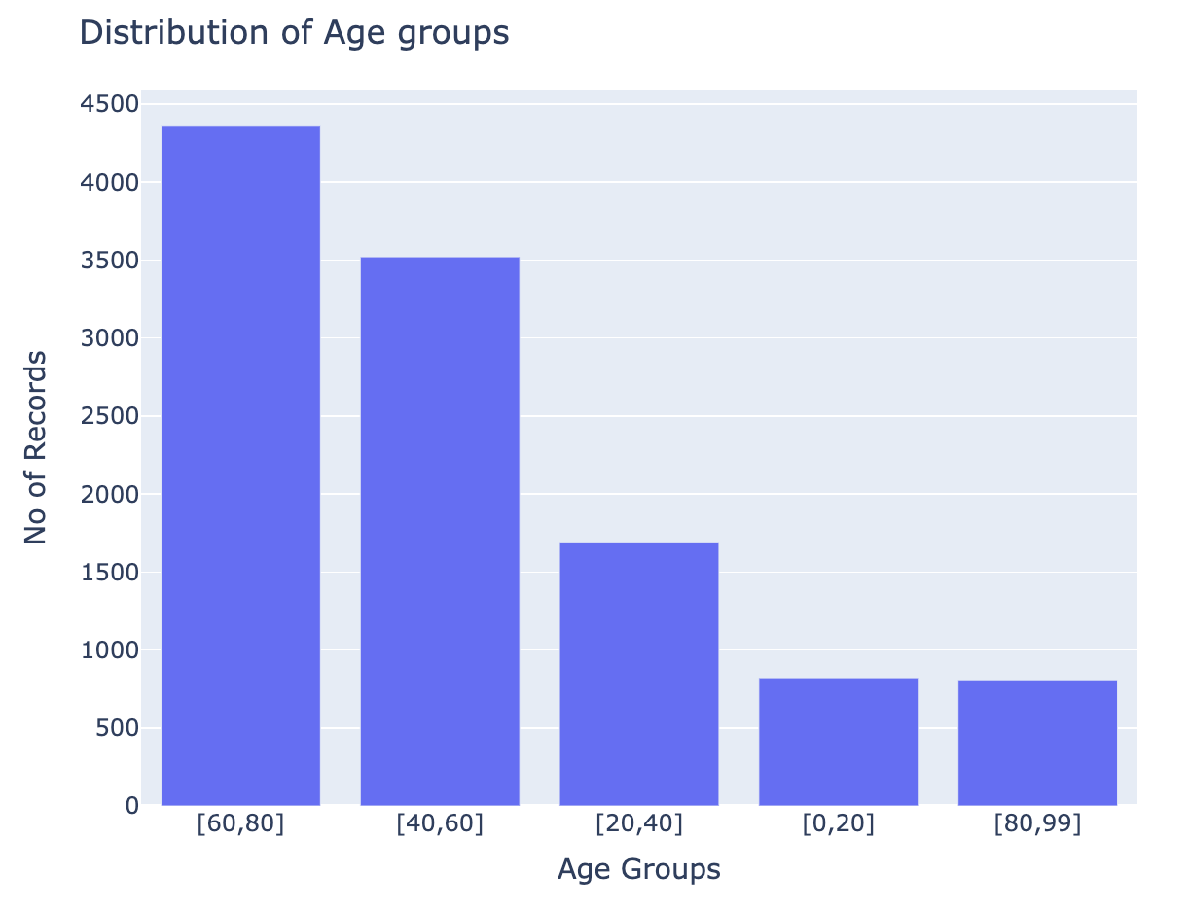
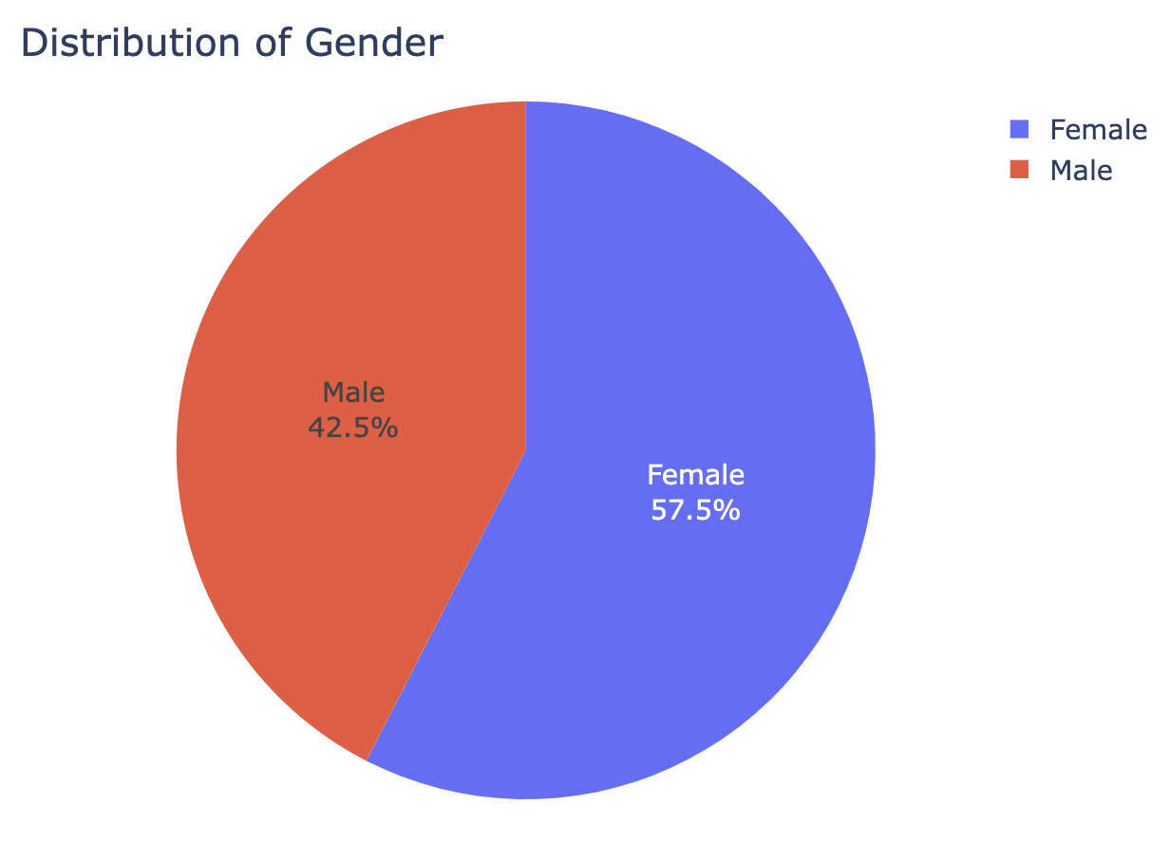
Exploratory Data Analysis

Slide 10
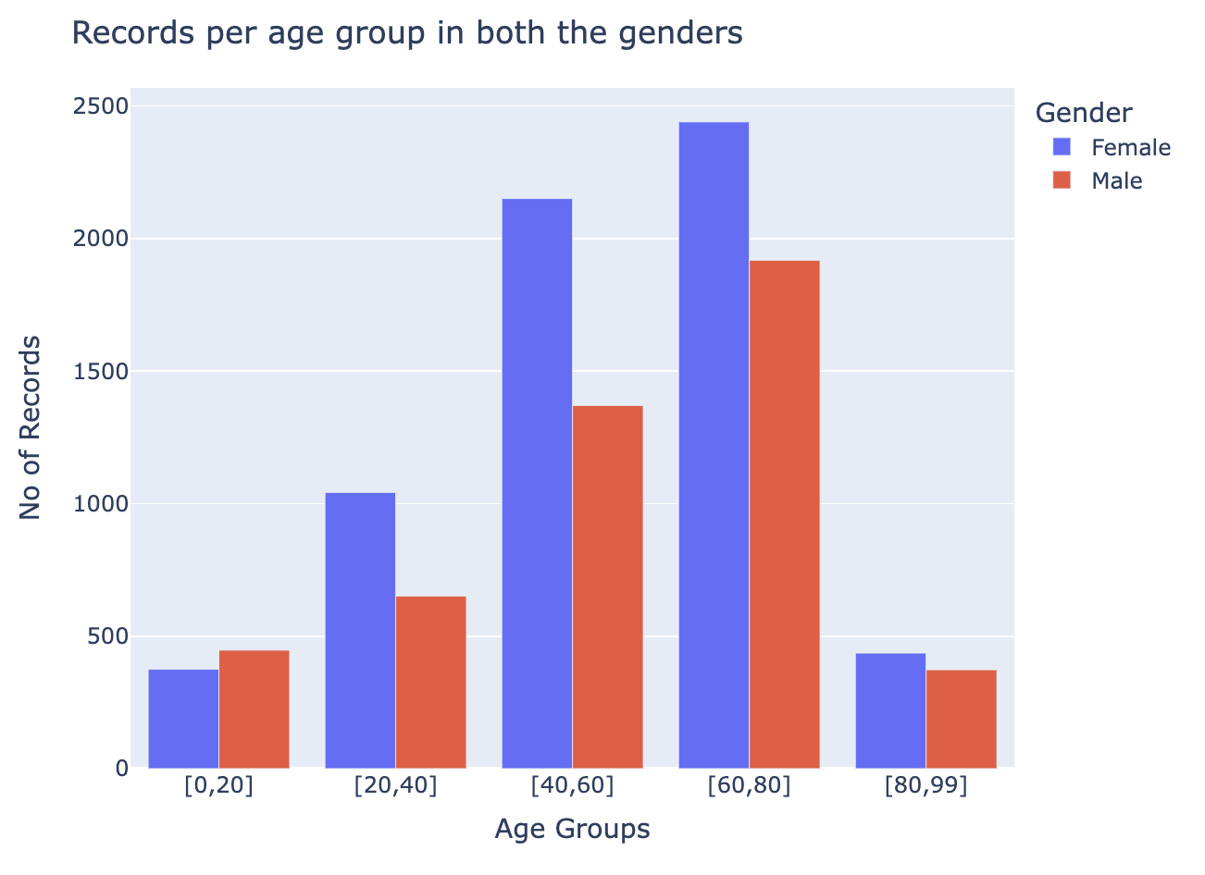

Slide 11
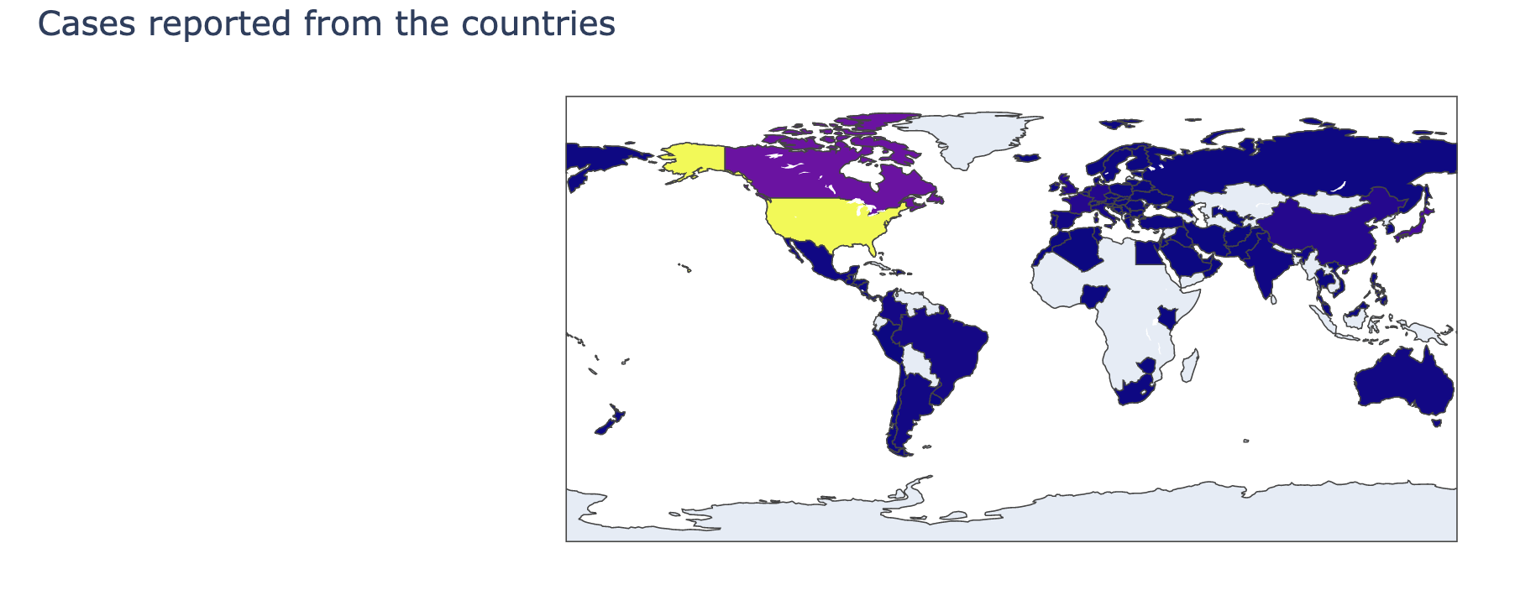
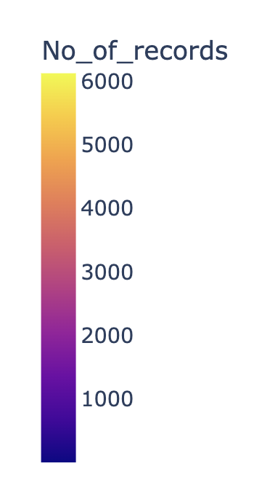

Slide 12
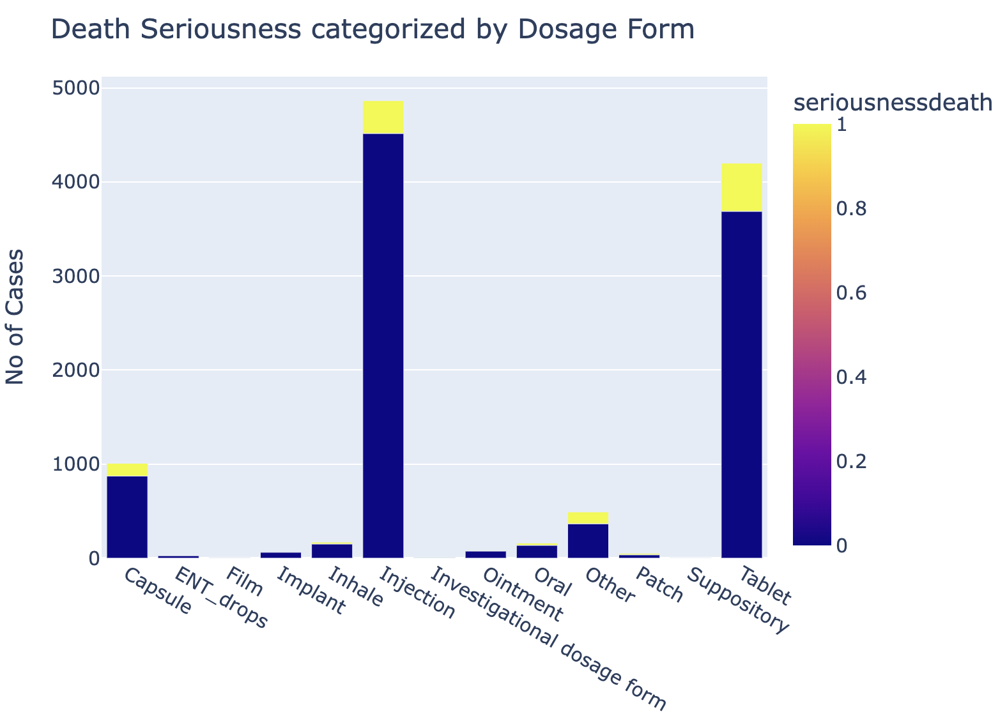
Comparison of various Serious levels categorizing Dosage form

Slide 13
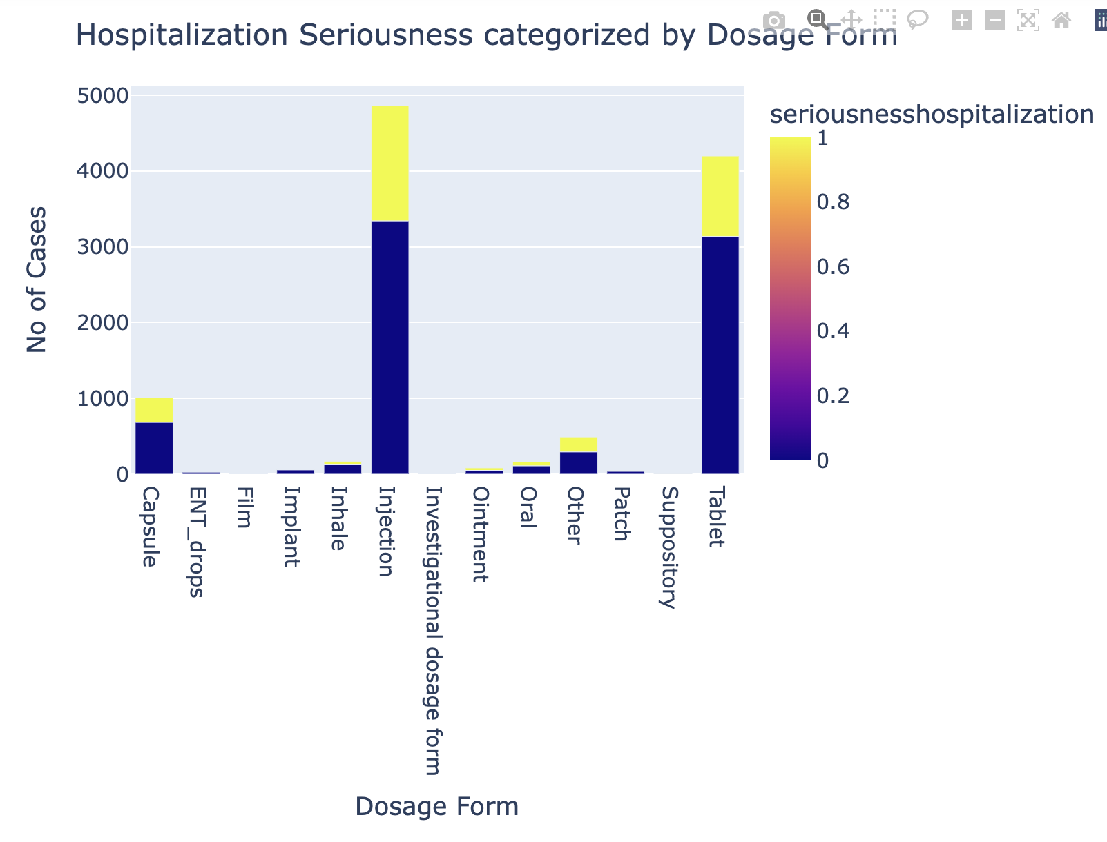

Slide 14
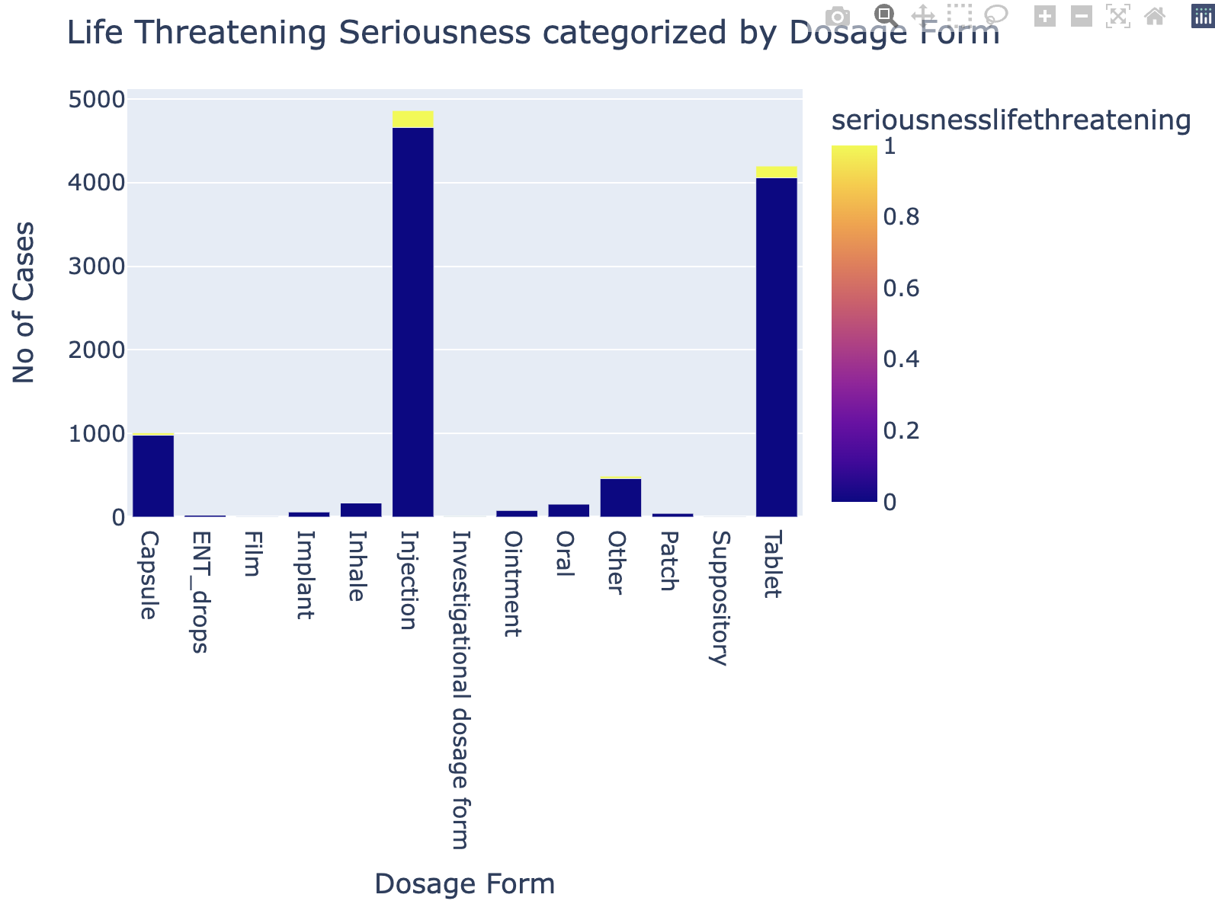

Slide 15
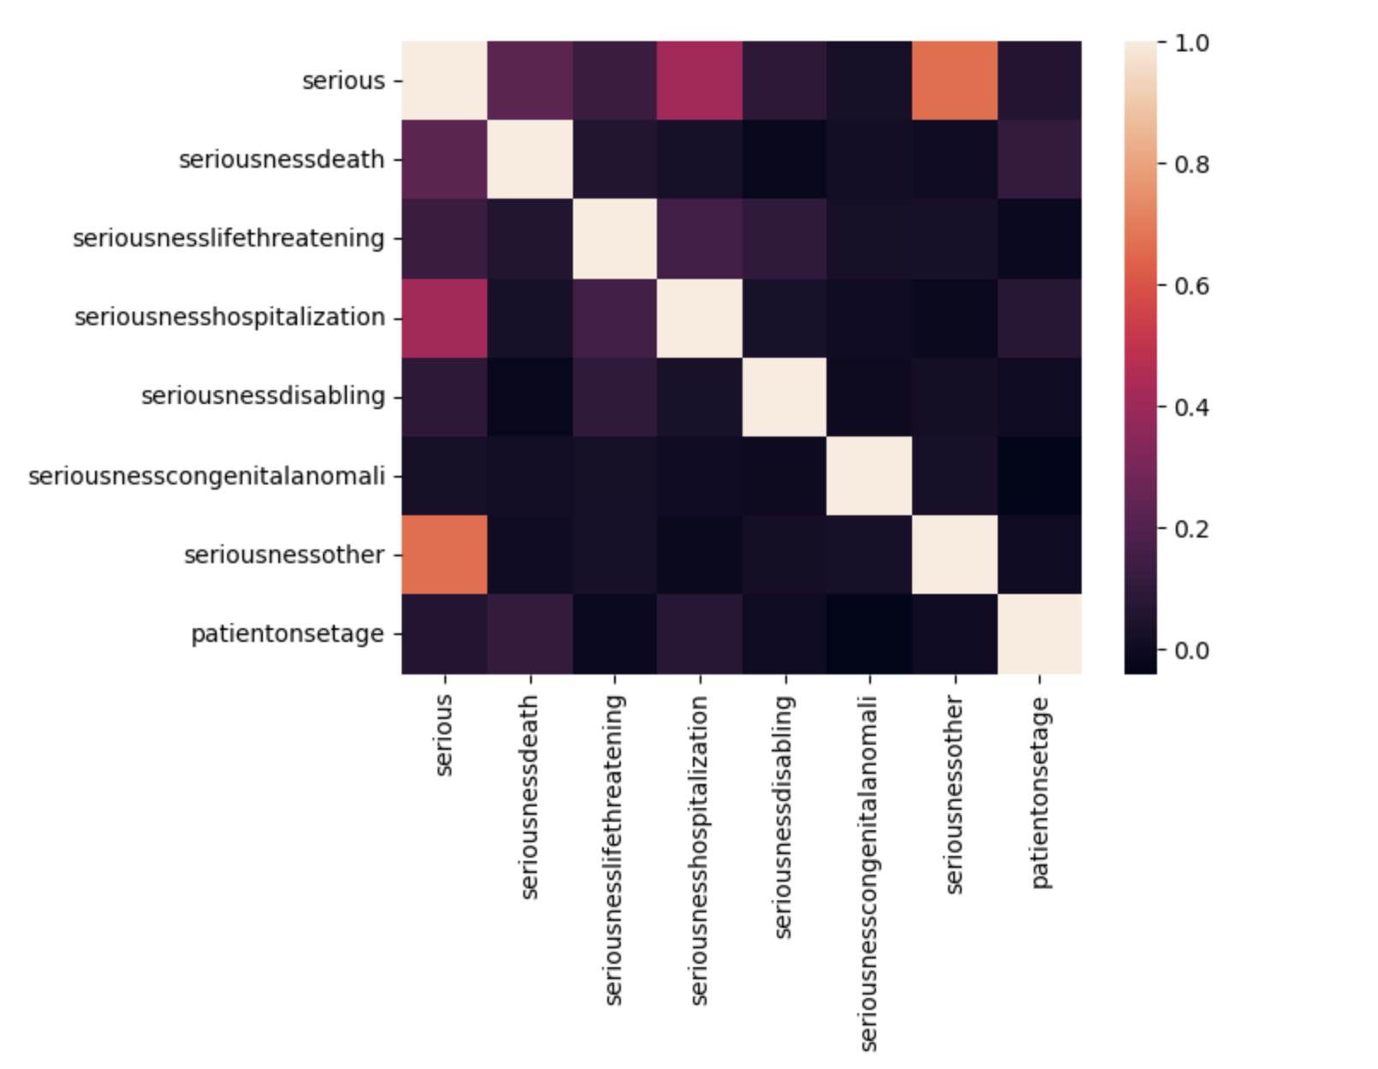
Correlation matrix

Slide 16
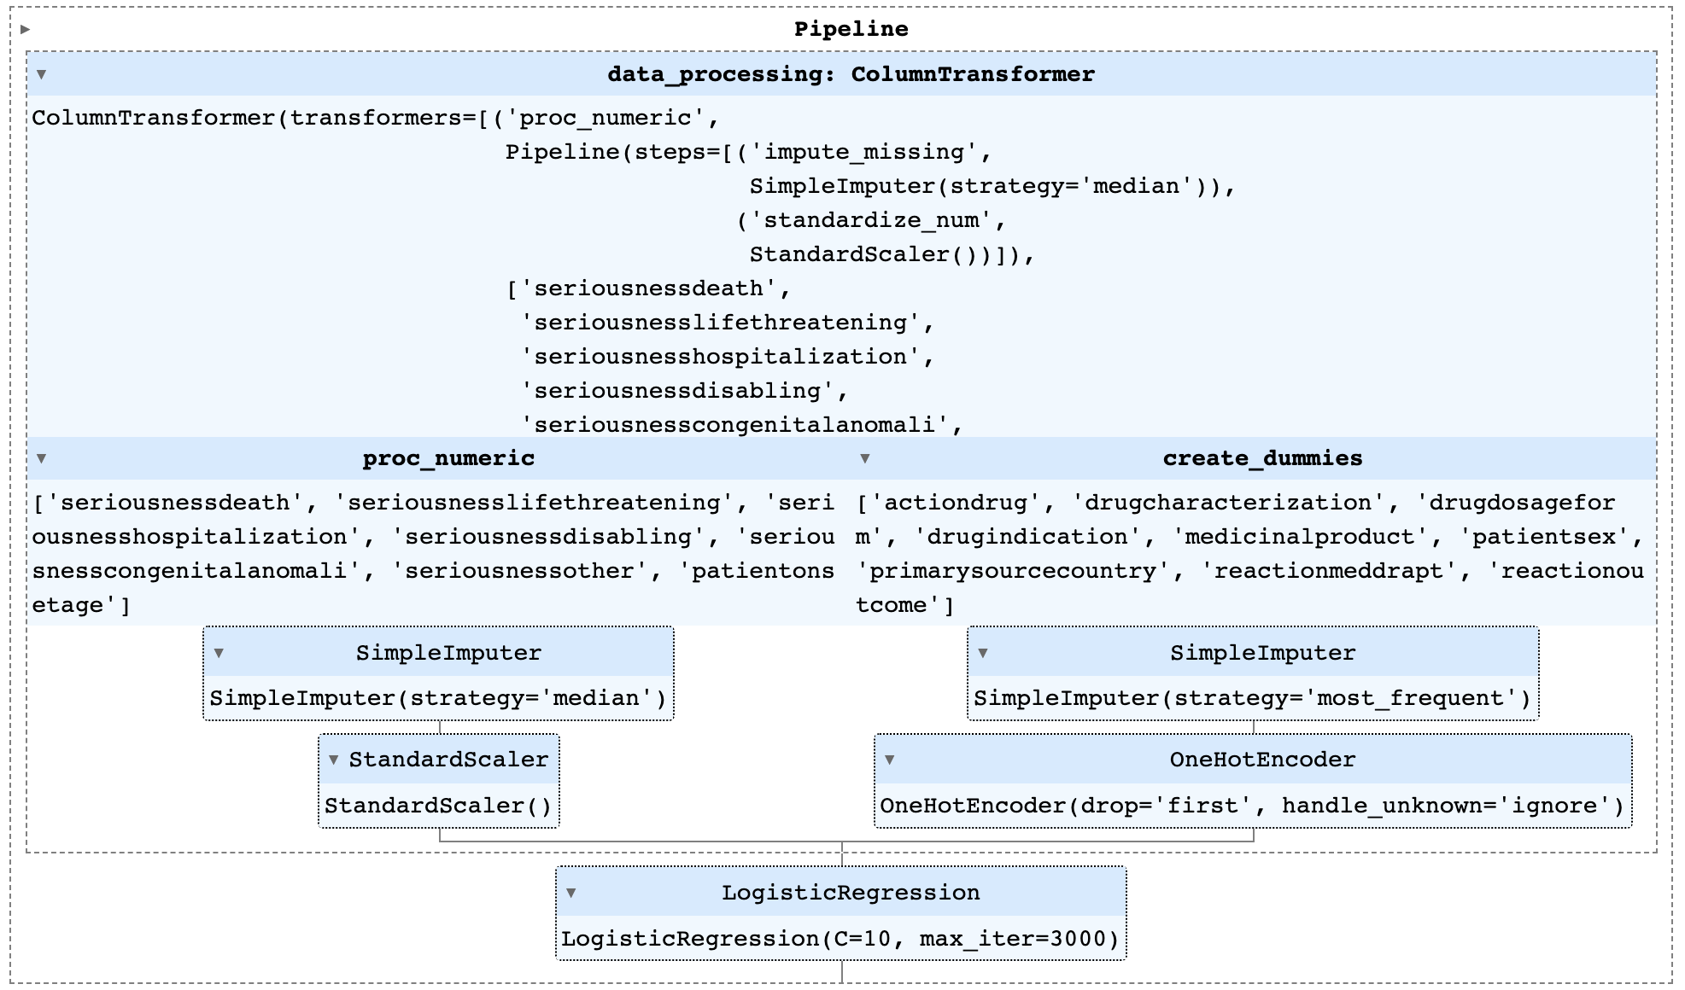
Logistic Regression

Slide 17
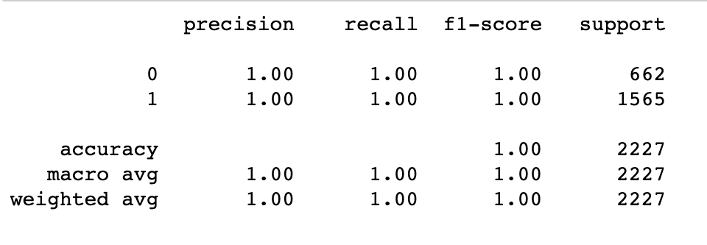
Classification report after secondary Gridsearchcv

Slide 18
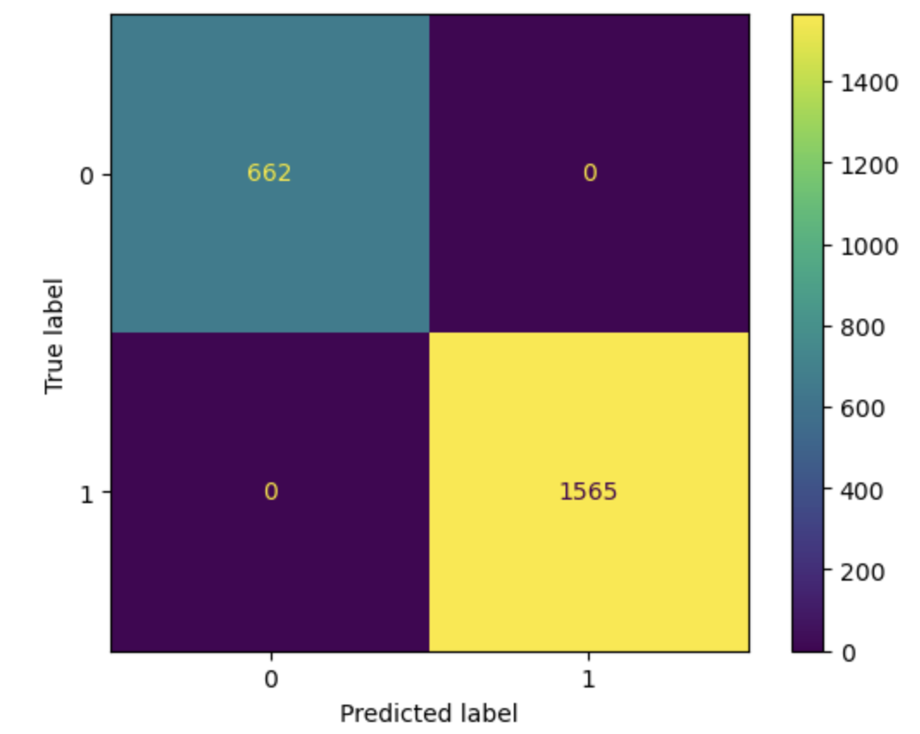
Confusion Matrix

Slide 19
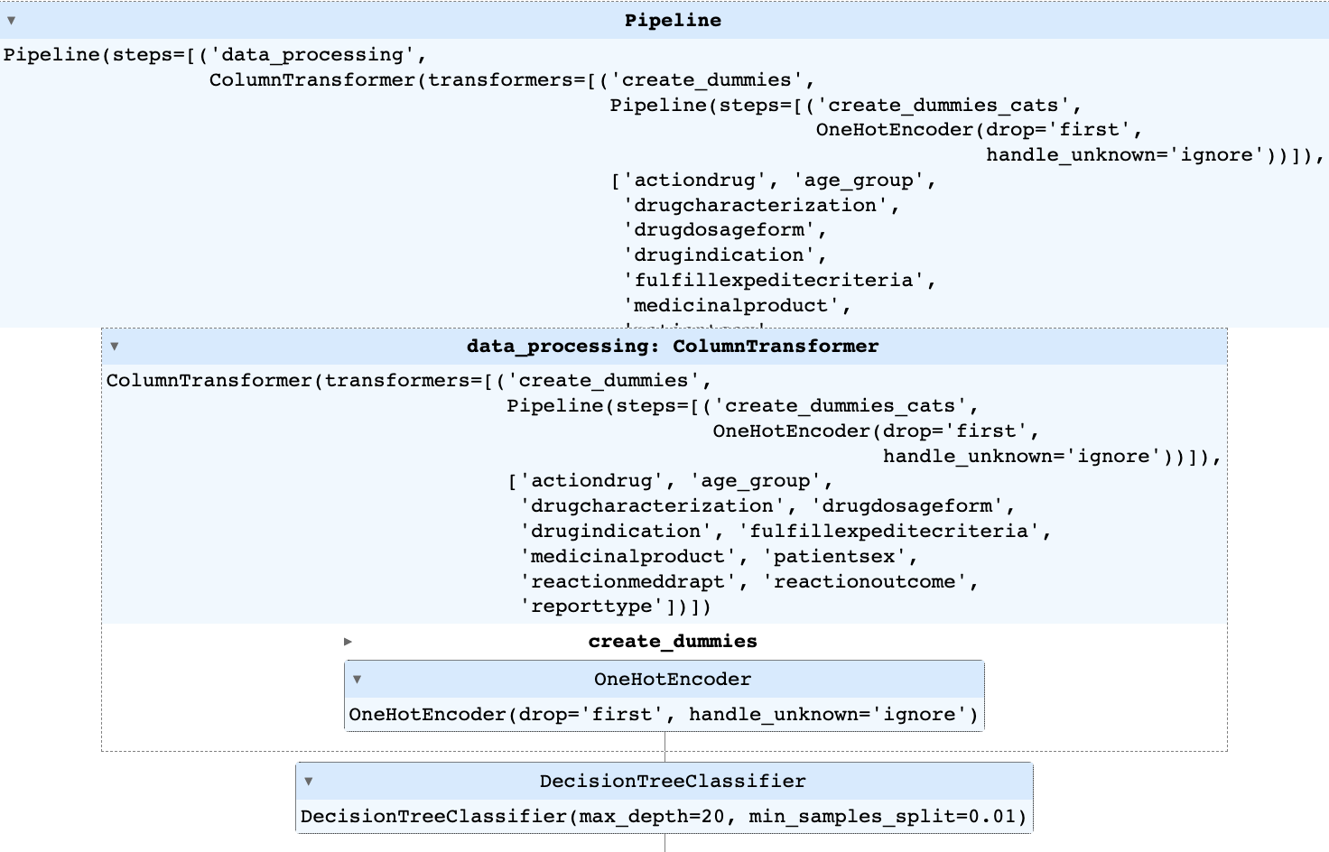
Decision Tree Classifier

Slide 20
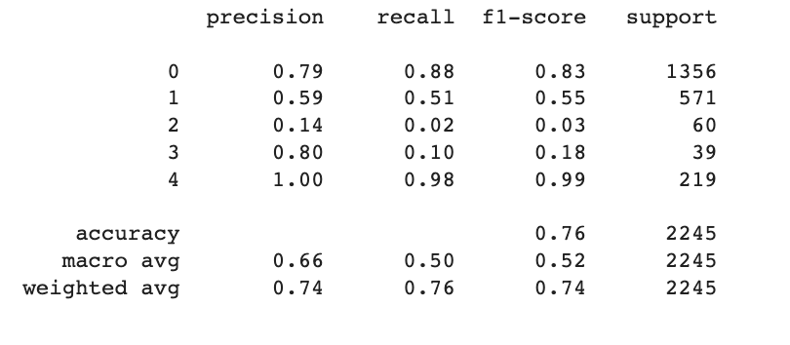
GridSearchCV Results
0 - no reaction
1 - hospitalization
2 - life threatening
3 - disabling
4 - death

Slide 21
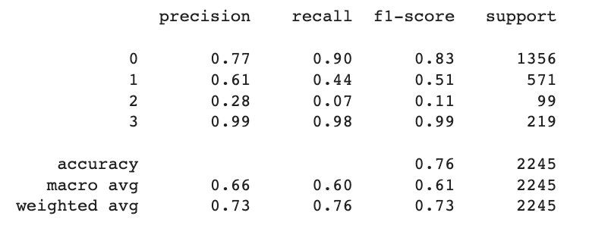
Secondary Gridsearchcv Results
0 - no reaction
1 - hospitalization
2 - life threatening or disabling
3 - death

Slide 22
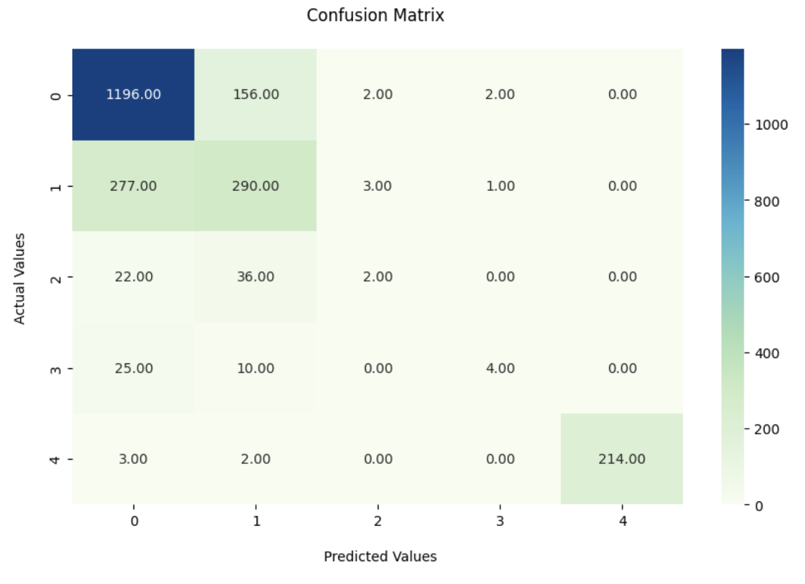
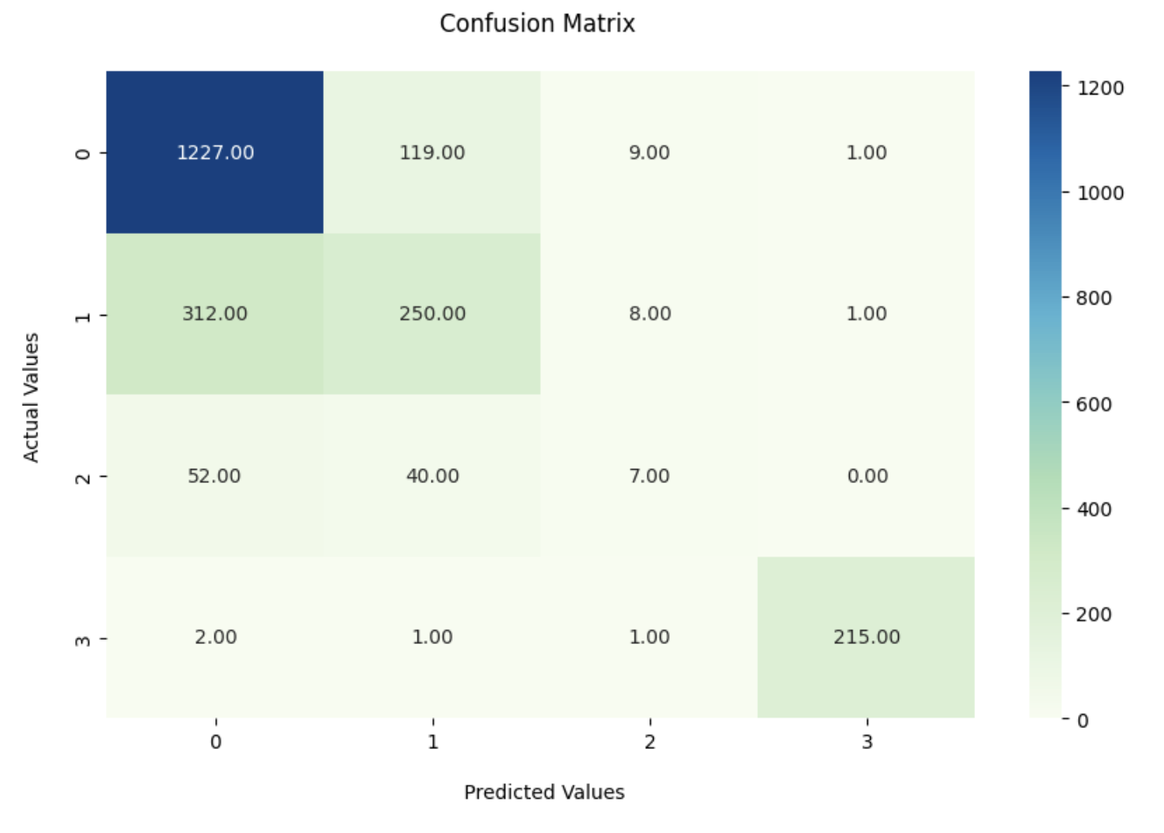
Multiclass Confusion Matrix
5 Classes
4 Classes

Slide 23
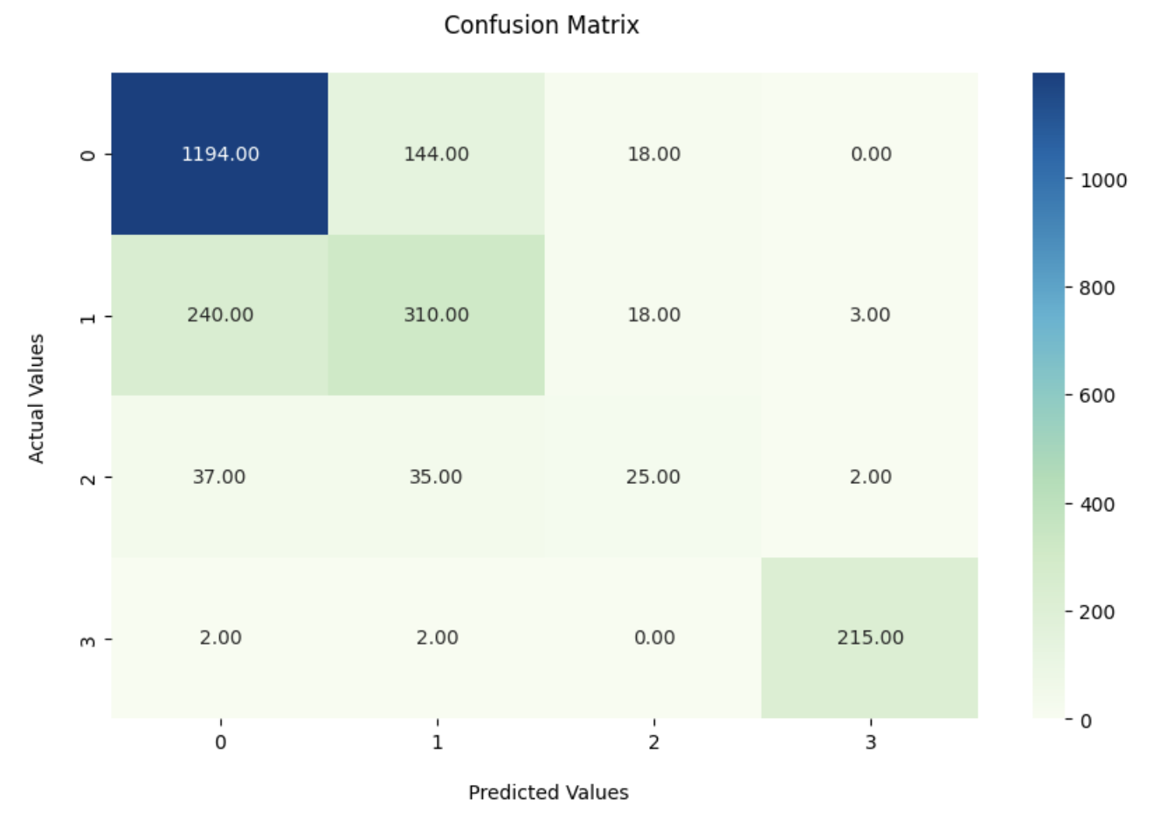
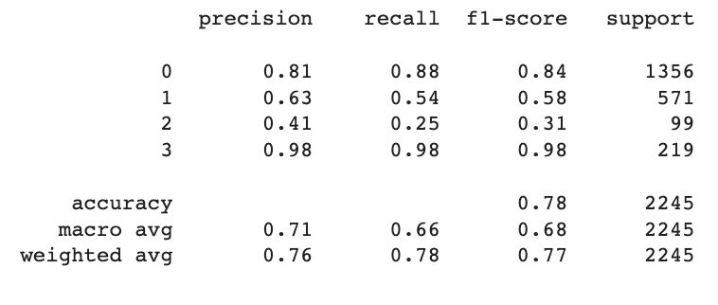
Logistic Regression for multiclass classification

Slide 24
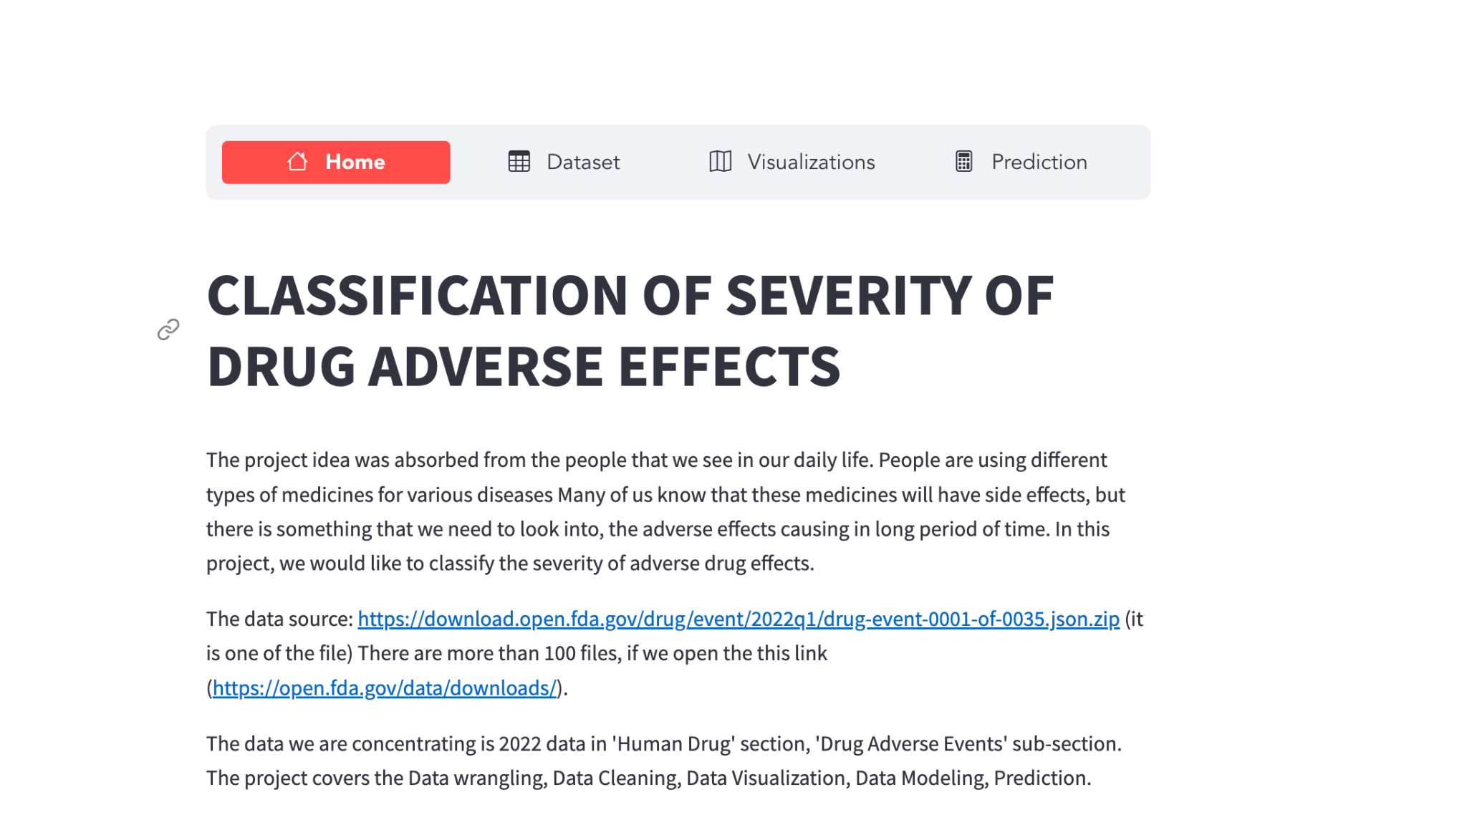
` Website Using Streamlit and Flask server

Slide 25
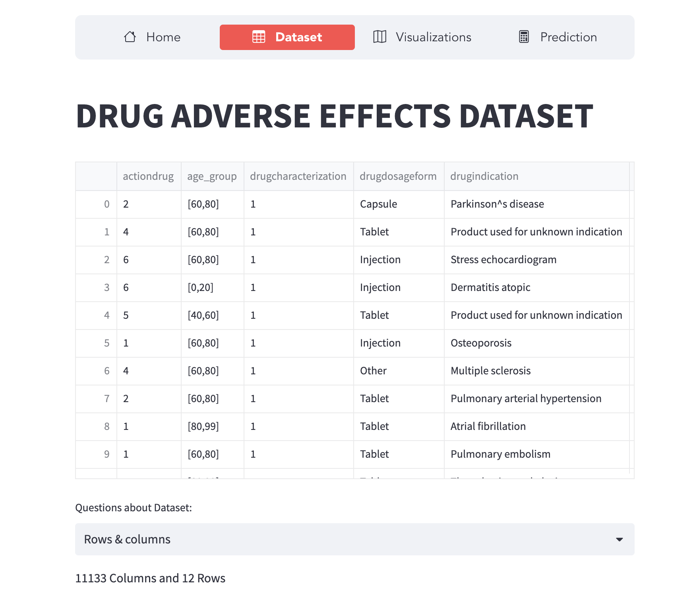

Slide 26
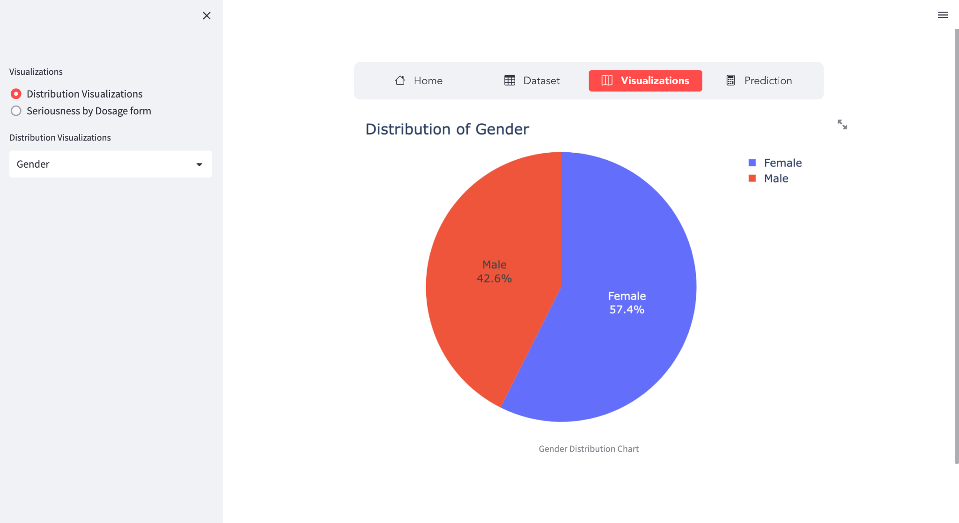

Slide 27
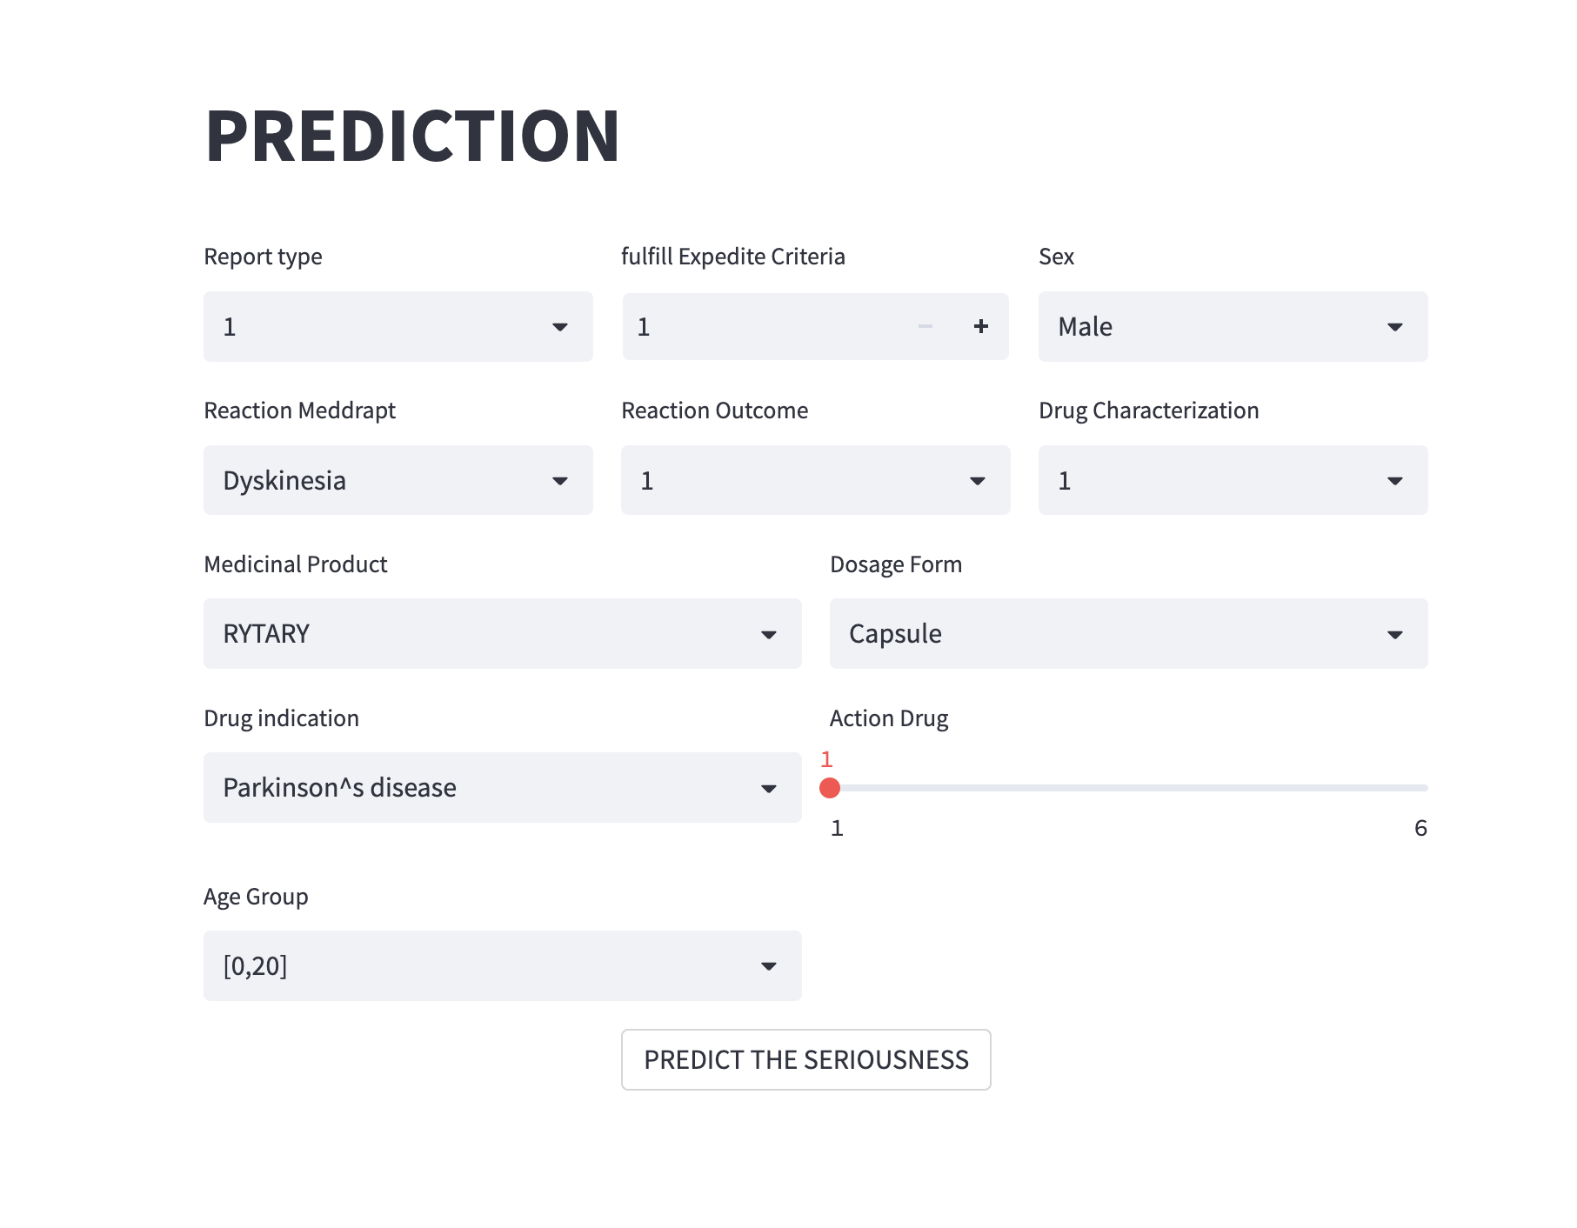

Slide 28
References:
https://open.fda.gov/data/downloads/
Galeano, D., Li, S., Gerstein, M., & Paccanaro, A. (2020). Predicting the frequencies of drug side effects. Nature Communications, 11(1). https://doi.org/10.1038/s41467-020-18305-y
Adverse Drug Events from Specific Medicines. (n.d.). Medication Safety Program. https://www.cdc.gov/medicationsafety/adverse-drug-events-specific-medicines.html#anchor_1558446012
Zhang, W., Liu, F., Luo, L., & Zhang, J. (2015). Predicting drug side effects by multi-label learning and ensemble learning. BMC Bioinformatics, 16(1). https://doi.org/10.1186/s12859-015-0774-y
Galeano, D., & Paccanaro, A. (2022). Machine learning prediction of side effects for drugs in clinical trials. Cell Reports Methods, 2(12), 100358. https://doi.org/10.1016/j.crmeth.2022.100358
The streamlit and flask from 690 Data driven Class notes and previous projects.

